Slide 1

Restaurant Service System
Full Stack Project

Slide 2
Restaurant Service System
(RS_Sys)
Technologies:
Java 17
Spring
AngularJS
Jenkens
Junit
AgileMethodology
GitHub
MySQL
Microservices
Spring:
Spring MVC,
Spring Data JPA,
Spring boot
Data JPA Test

Slide 3
Software features
RS_Sys
Customer Api allow customer :
Access order web page, select order item and submit form.
Customer Controller Send request to accept order send confirmation to the client.
Order_Service api accept request from Controller api and perform business logic at service api and use repository api to
Repository api perform CRUP operation using Spring Data JPAJPA into MySql Database.
Admin api allow user to add and delete from menu items’

Slide 4
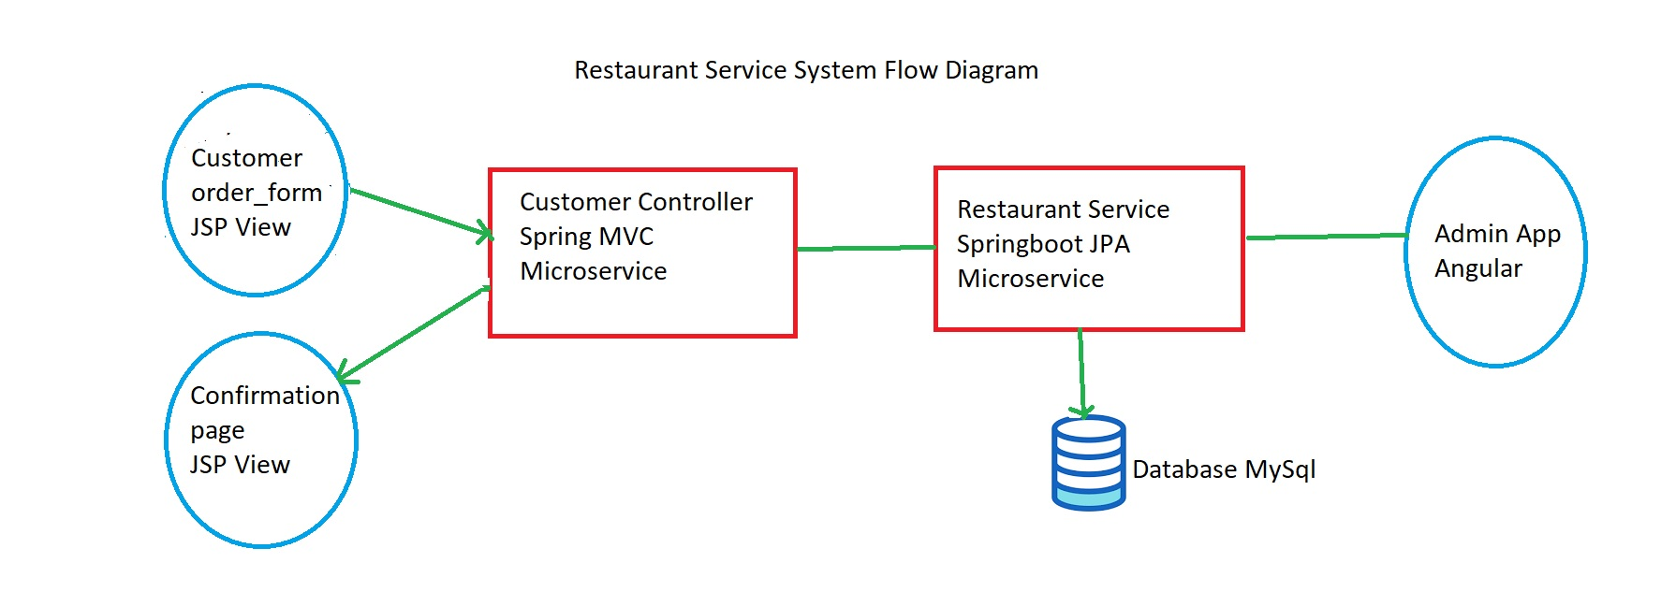
RS_Sys

Slide 5
microservices
RS_Sys
Customer Controller Service
Restaurant Service
Service api for business logic.
Repository api perform CRUD operations to tables Order, MenuItem, and OrderItem to Mysql Database using Spring Data JPA.
Entities classes for Order, Menuitem, and OrdereItem.

Slide 6
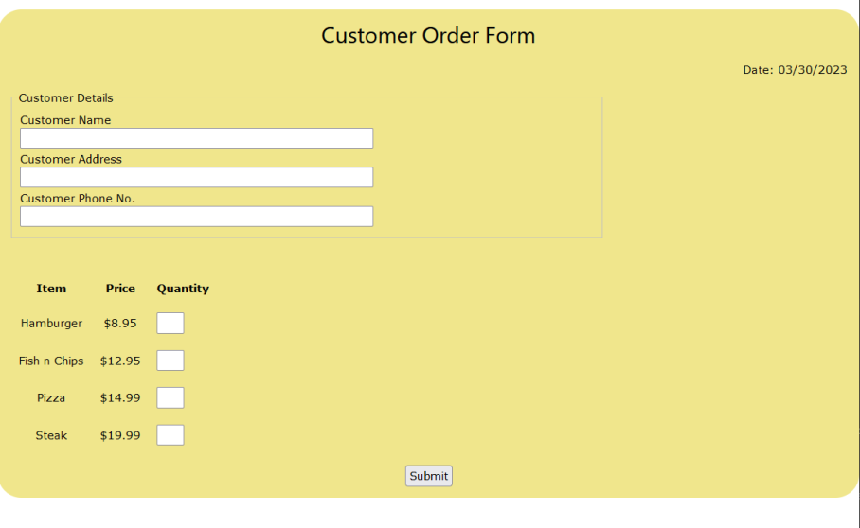
Customer order form
RS_Sys
Technologies :
Features:

Slide 7
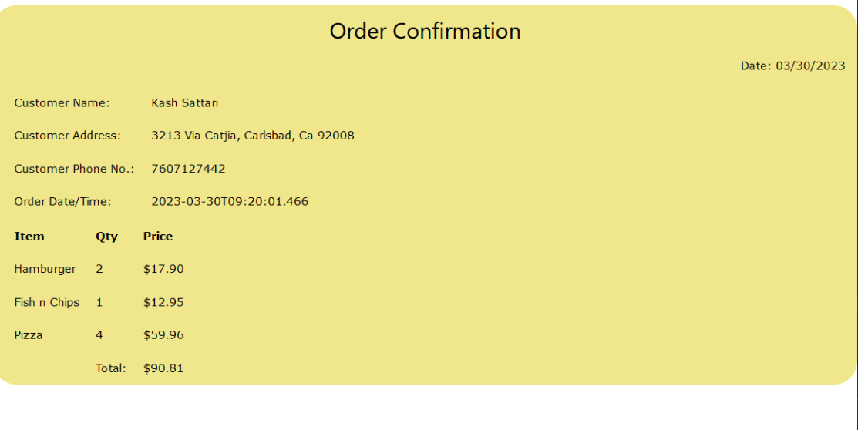
confirmation form
RS_Sys
Technologies :
Features:

Slide 8
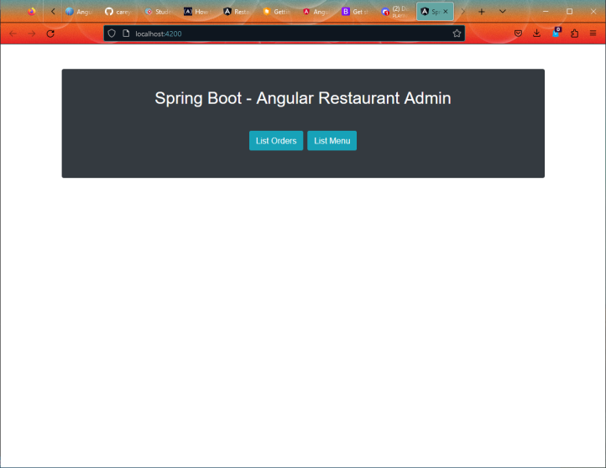
Admin application
RS_Sys
Technologies :
Features:

Slide 9
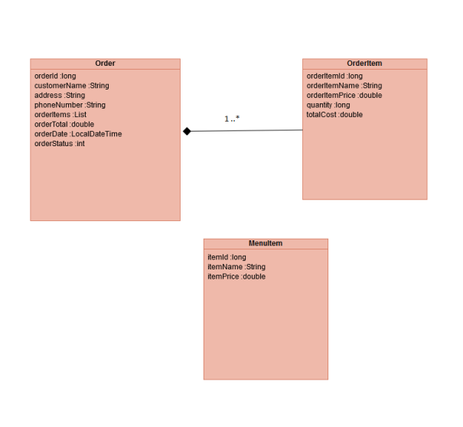

Database mysql
RS_Sys
Class Diagrams
Tables:
menu
order_Service
order_Item

